Slide 1
Chapter 11:
Data and Database Administration
Modern Database Management
10^{h} Edition
Jeffrey A. Hoffer, V. Ramesh,
Heikki Topi
© 2011 Pearson Education, Inc. Publishing as Prentice Hall

Slide 2
Objectives
Define terms
List functions and roles of data/database administration
Describe role of data dictionaries and information repositories
Compare optimistic and pessimistic concurrency control
Describe problems and techniques for data security
Understand role of databases in Sarbanes-Oxley compliance
Describe problems and facilities for data recovery
Describe database tuning issues and list areas where changes can be done to tune the database
Describe importance and measures of data availability

Slide 3
Traditional Administration Definitions
Data Administration: A high-level function that is responsible for the overall management of data resources in an organization, including maintaining corporate-wide definitions and standards
Database Administration: A technical function that is responsible for physical database design and for dealing with technical issues such as security enforcement, database performance, and backup and recovery

Slide 4
Traditional Data Administration Functions
Data policies, procedures, standards
Planning
Data conflict (ownership) resolution
Managing the information repository
Internal marketing of DA concepts

Slide 5
Traditional Database Administration Functions
Analyzing and designing databases
Selection of DBMS and software tools
Installing/upgrading DBMS
Tuning database performance
Improving query processing performance
Managing data security, privacy, and integrity
Data backup and recovery

Slide 6
Data Warehouse Administration
New role, coming with the growth in data warehouses
Similar to DA/DBA roles
Emphasis on integration and coordination of metadata/data across many data sources
Specific roles:
  Support DSS applications
  Manage data warehouse growth
  Establish service level agreements regarding data warehouses and data marts

Slide 7
Open Source DBMSs
An alternative to proprietary packages such as Oracle, Microsoft SQL Server, or Microsoft Access
mySQL is an example of an open-source DBMS
Less expensive than proprietary packages
Source code available, for modification
Absence of complete documentation
Ambiguous licensing concerns
Not as feature-rich as proprietary DBMSs
Vendors may not have certification programs

Slide 8
Database Security
Database Security: Protection of the data against accidental or intentional loss, destruction, or misuse
Increased difficulty due to Internet access and client/server technologies

Slide 9
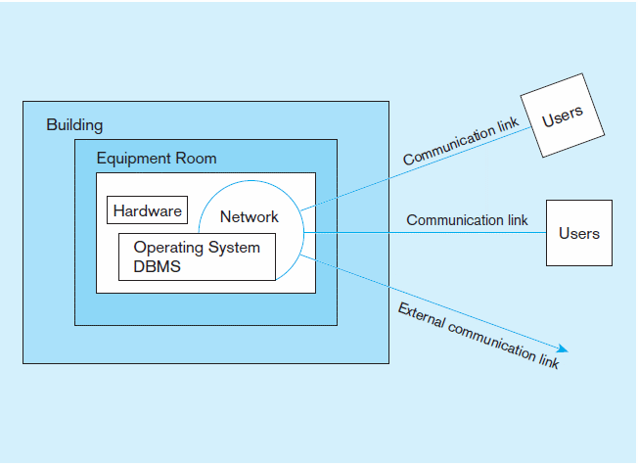
Figure 11-2 Possible locations of data security threats

Slide 10
Threats to Data Security
Accidental losses attributable to:
  Human error
  Software failure
  Hardware failure
Theft and fraud
Loss of privacy or confidentiality
  Loss of privacy (personal data)
  Loss of confidentiality (corporate data)
Loss of data integrity
Loss of availability (through, e.g. sabotage)

Slide 11
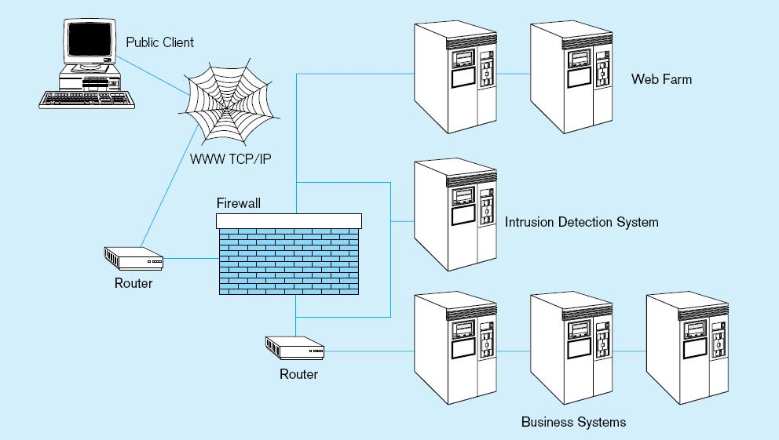
Figure 11-3 Establishing Internet Security

Slide 12
Web Security
Static HTML files are easy to secure
  Standard database access controls
  Place Web files in protected directories on server
Dynamic pages are harder
  User authentication
  Session security
  SSL for encryption
  Restrict number of users and open ports
  Remove unnecessary programs

Slide 13
W3C Web Privacy Standard
Platform for Privacy Protection (P3P)
Addresses the following:
  Who collects data
  What data is collected and for what purpose
  Who is data shared with
  Can users control access to their data
  How are disputes resolved
  Policies for retaining data
  Where are policies kept and how can they be accessed

Slide 14
Database Software Security Features
Views or subschemas
Integrity controls
Authorization rules
User-defined procedures
Encryption
Authentication schemes
Backup, journalizing, and checkpointing

Slide 15
Views and Integrity Controls
Views
  Subset of the database that is presented to one or more users
  User can be given access privilege to view without allowing access privilege to underlying tables
Integrity Controls
  Protect data from unauthorized use
  Domains–set allowable values
  Assertions–enforce database conditions
  Triggers – prevent inappropriate actions, invoke special handling procedures, write to log files

Slide 16
Authorization Rules
Controls incorporated in the data management system
➔Restrict:
  access to data
  actions that people can take on data
➔Authorization matrix for:
  Subjects
  Objects
  Actions
  Constraints

Slide 17
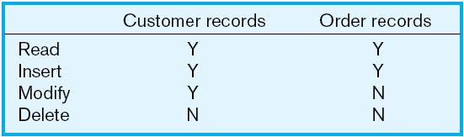
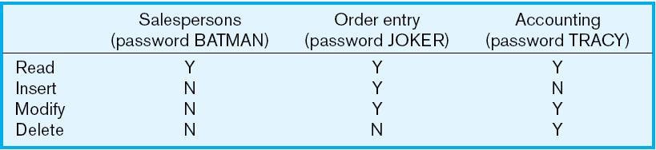
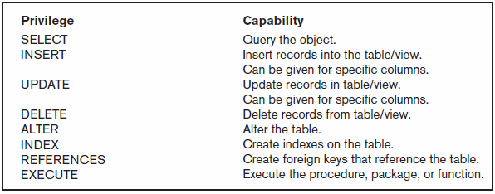
Figure 11-5a Authorization table for subjects (salespersons)
Implementing authorization rules
Figure 11-5b Authorization table for objects (orders)
Figure 11-6 Oracle privileges
Some DBMSs also provide capabilities for user-defined procedures to customize the authorization process

Slide 18
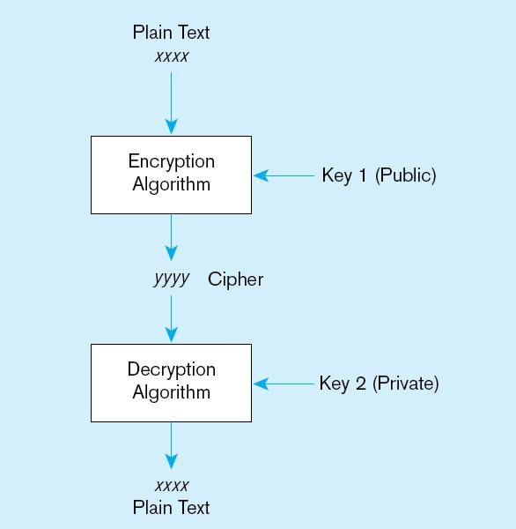
Figure 11-7 Basic two-key encryption
Encryption – the coding or scrambling of data so that humans cannot read them
Secure Sockets Layer (SSL) is a popular encryption scheme for TCP/IP connections

Slide 19
Authentication Schemes
Goal – obtain a positive identification of the user
Passwords: First line of defense
  Should be at least 8 characters long
  Should combine alphabetic and numeric data
  Should not be complete words or personal information
  Should be changed frequently

Slide 20
Authentication Schemes (cont.)
Strong Authentication
  Passwords are flawed:
    Users share them with each other
    They get written down, could be copied
    Automatic logon scripts remove need to explicitly type them in
    Unencrypted passwords travel the Internet
Possible solutions:
  Two factor–e.g. smart card plus PIN
  Three factor–e.g. smart card, biometric, PIN

Slide 21
Sarbanes-Oxley (SOX)
Requires companies to audit the access to sensitive data
Designed to ensure integrity of public companies’ financial statements
SOX audit involves:
  IT change management
  Logical access to data
  IT operations

Slide 22
IT Change Management
The process by which changes to operational systems and databases are authorized
For database, changes to: schema, database configuration, updates to DBMS software
Segregation of duties: development, test, production

Slide 23
Logical Access to Data
Personnel controls
  Hiring practices, employee monitoring, security training, separation of duties
Physical access controls
    Swipe cards, equipment locking, check-out procedures, screen placement, laptop protection

Slide 24
IT Operations
Policies and procedures for day-to-day management of infrastructure, applications, and databases in an organization
For databases: backup, recovery, availability

Slide 25
Database Recovery
Mechanism for restoring a database quickly and accurately after loss or damage
Recovery facilities:
  Backup Facilities
  Journalizing Facilities
  Checkpoint Facility
  Recovery Manager

Slide 26
Back-up Facilities
DBMS copy utility that produces backup copy of the entire database or subset
Periodic backup (e.g. nightly, weekly)
Cold backup–database is shut down during backup
Hot backup–selected portion is shut down and backed up at a given time
Backups stored in secure, off-site location

Slide 27
Journalizing Facilities
Audit trail of transactions and database updates
Transaction log–record of essential data for each transaction processed against the database
Database change log–images of updated data
  Before-image–copy before modification
  After-image–copy after modification
Produces an audit trail

Slide 28
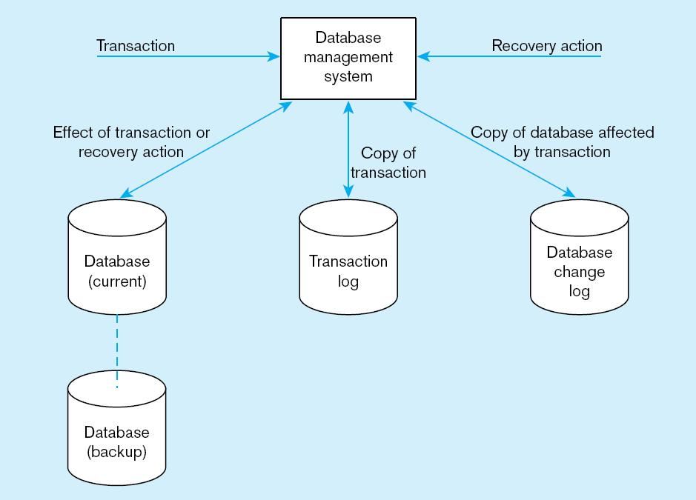
Figure 11-8 Database audit trail
From the backup and logs, databases can be restored in case of damage or loss

Slide 29
Checkpoint Facilities
DBMS periodically refuses to accept new transactions
➔ system is in a quiet state
Database and transaction logs are synchronized
This allows recovery manager to resume processing from short period, instead of repeating entire day

Slide 30
Recovery and Restart Procedures
Disk Mirroring–switch between identical copies of databases
Restore/Rerun–reprocess transactions against the backup
Transaction Integrity–commit or abort all transaction changes
Backward Recovery (Rollback)–apply before images
Forward Recovery (Roll Forward)–apply after images (preferable to restore/rerun)

Slide 31
Transaction ACID Properties
Atomic
  Transaction cannot be subdivided
Consistent
  Constraints don’t change from before transaction to after transaction
Isolated
  Database changes not revealed to users until after transaction has completed
Durable
  Database changes are permanent

Slide 32
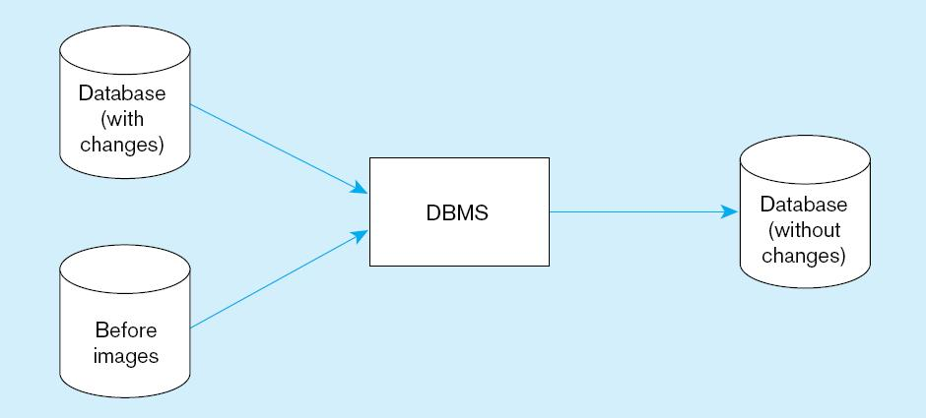
Figure 11-9 Basic recovery techniques
a) Rollback

Slide 33
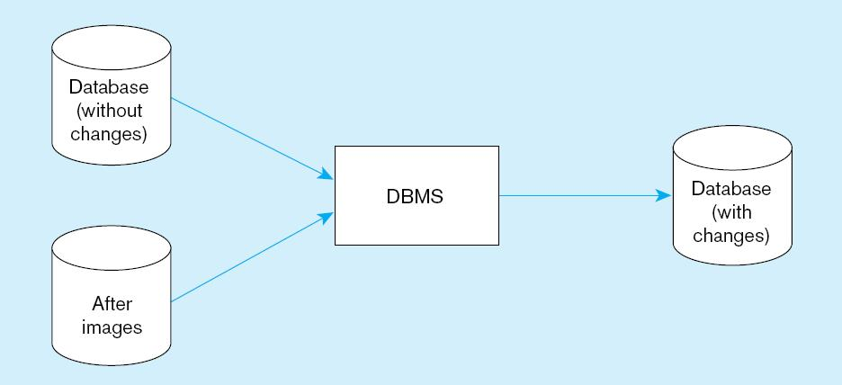
Figure 11-9 Basic recovery techniques (cont.)
b) Rollforward

Slide 34
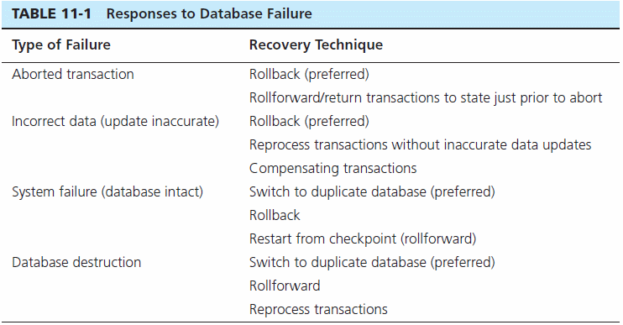

Slide 35
Concurrency Control
Problem–in a multi-user environment, simultaneous access to data can result in interference and data loss
Solution–Concurrency Control
  The process of managing simultaneous operations against a database so that data integrity is maintained and the operations do not interfere with each other in a multi-user environment

Slide 36
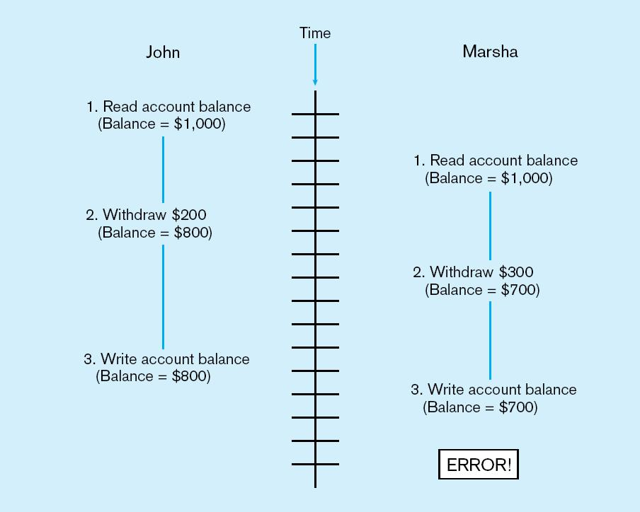
Figure 11-10 Lost update (no concurrency control in effect)
Simultaneous access causes updates to cancel each other
A similar problem is the inconsistent read problem

Slide 37
Concurrency Control Techniques
Serializability
  Finish one transaction before starting another
Locking Mechanisms
  The most common way of achieving serialization
  Data that is retrieved for the purpose of updating is locked for the updater
  No other user can perform update until unlocked

Slide 38
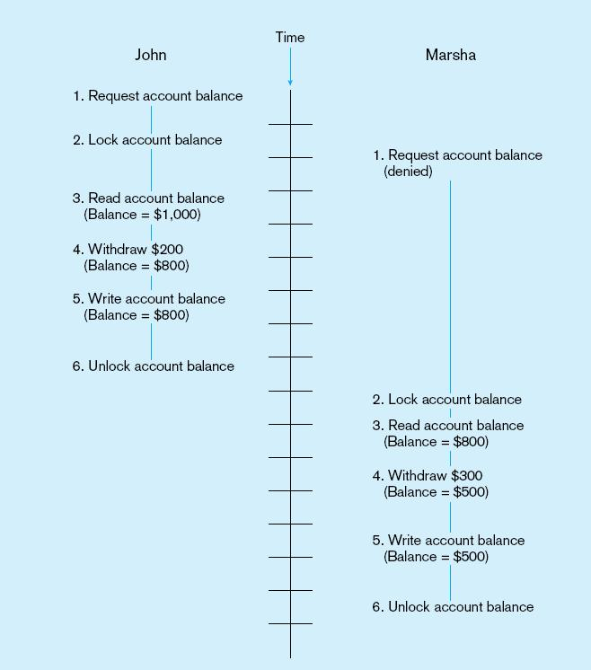
Figure 11-11: Updates with locking (concurrency control)
This prevents the lost update problem

Slide 39
Locking Mechanisms
Locking level:
  Database–used during database updates
  Table–used for bulk updates
  Block or page–very commonly used
  Record–only requested row; fairly commonly used
  Field–requires significant overhead; impractical
Types of locks:
  Shared lock–Read but no update permitted. Used when just reading to prevent another user from placing an exclusive lock on the record
  Exclusive lock–No access permitted. Used when preparing to update

Slide 40
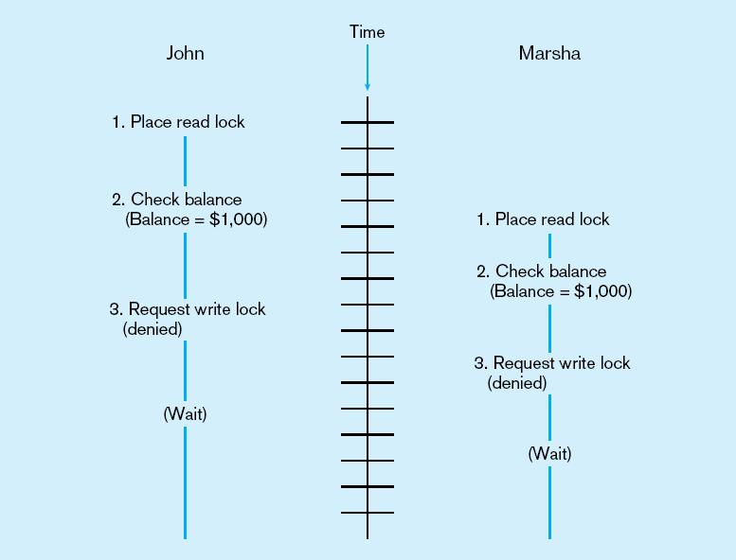
Deadlock
An impasse that results when two or more transactions have locked common resources, and each waits for the other to unlock their resources
Figure 11-12
The problem of deadlock
John and Marsha will wait forever for each other to release their locked resources!

Slide 41
Managing Deadlock
Deadlock prevention:
  Lock all records required at the beginning of a transaction
  Two-phase locking protocol
    Growing phase
    Shrinking phase
  May be difficult to determine all needed resources in advance
Deadlock Resolution:
  Allow deadlocks to occur
  Mechanisms for detecting and breaking them
    Resource usage matrix

Slide 42
Versioning
Optimistic approach to concurrency control
Instead of locking
Assumption is that simultaneous updates will be infrequent
Each transaction can attempt an update as it wishes
The system will reject an update when it senses a conflict
Use of rollback and commit for this

Slide 43
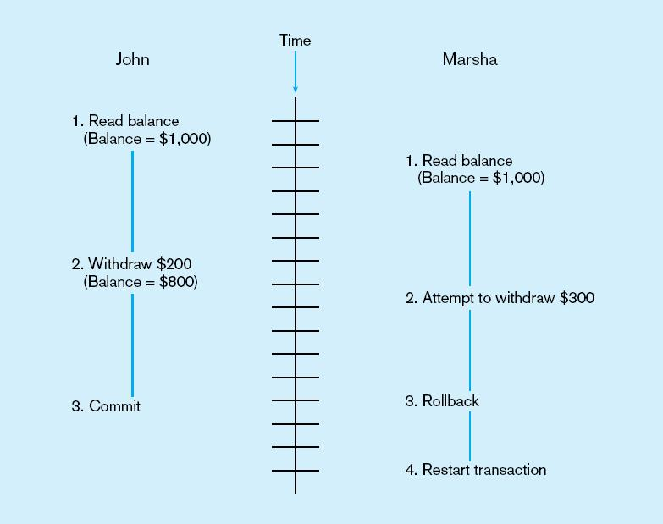
Figure 11-14 The use of versioning
Better performance than locking

Slide 44
Data Dictionaries and Repositories
Data dictionary
  Documents data elements of a database
System catalog
  System-created database that describes all database objects
Information Repository
  Stores metadata describing data and data processing resources
Information Repository Dictionary System (IRDS)
  Software tool managing/controlling access to information repository

Slide 45
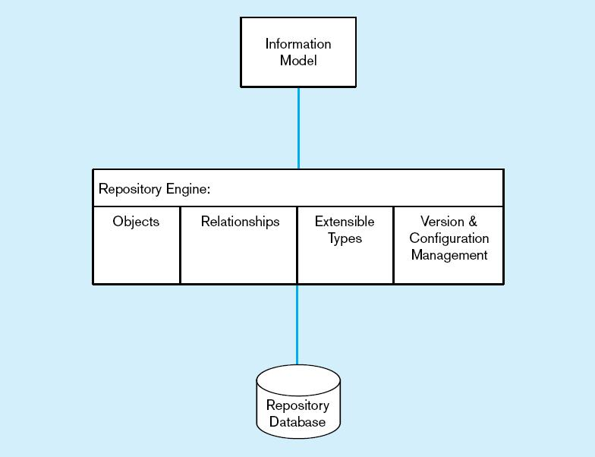
Figure 11-15 Three components of the repository system architecture
A schema of the repository information
Software that manages the repository objects
Where repository objects are stored
Source: adapted from Bernstein, 1996.

Slide 46
Database Performance Tuning
DBMS Installation
  Setting installation parameters
Memory and Storage Space Usage
  Set cache levels
  Choose background processes
  Data archiving
Input/output (I/O) Contention
  Use striping
  Distribution of heavily accessed files
CPU Usage – Monitor CPU load
Application tuning
  Modification of SQL code in applications
  Use of heartbeat queries

Slide 47
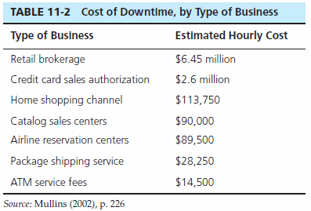
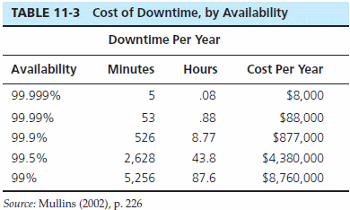
Cost of Downtime
Downtime is expensive

Slide 48
Data Availability
How to ensure availability
  Hardware failures–provide redundancy for fault tolerance
  Loss of data–database mirroring
  Human error–standard operating procedures, training, documentation
  Maintenance downtime–automated and non-disruptive maintenance utilities
  Network problems–careful traffic monitoring, firewalls, and routers

Slide 49

All rights reserved. No part of this publication may be reproduced, stored in a retrieval system, or transmitted, in any form or by any means, electronic, mechanical, photocopying, recording, or otherwise, without the prior written permission of the publisher. Printed in the United States of America.
Copyright © 2011 Pearson Education, Inc. Publishing as Prentice Hall

